Slide 1


Slide 2
Generations of Computers
Athar Abbas

Slide 3
Outline
Early Computers
First Generation Computers
Second Generation Computers
Third Generation Computers
Fourth Generation Computers
Fifth Generation Computers
Future of Computers

Slide 4
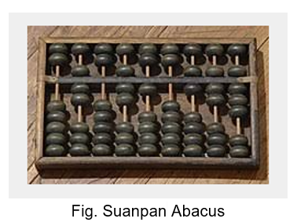
Early Computers
History of Computers goes back to ancient times when Abacus was used for calculations , nearly 2500 years ago in Mesopotamia.
Lesser known computing devices were invented in later centuries.
Late 19th century begin a journey towards modern computing devices. Tabulating machine , babbage computers was one of the devices of that time.

Slide 5
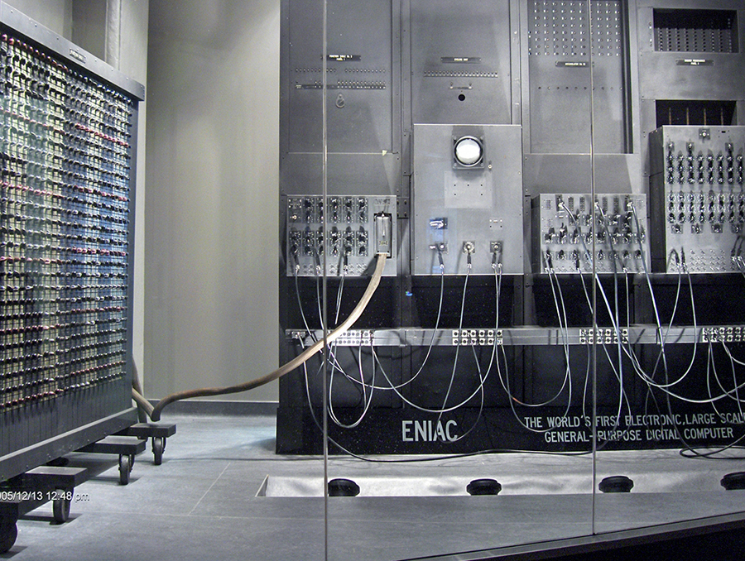
First Generation Computers (1940 – 56)
First Generation Computers were massive often taking up space of a whole room.
It used vaccum tubes to operate.
They consumed electricity in enormous amount and generated much heat.
ENIAC -a first generation computer- was developed in 1945 , for military usage. UNIVAC was also a computer of this era , designed by US Census Beauru in 1952 for analyzing votes.

Slide 6
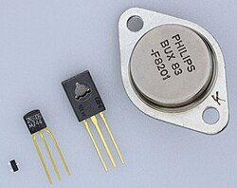
Second Generation Computers (1956 – 63)
This generation marked the beginning of use of transistors in computers. They are tiny electronic devices acts as switch in circuits , made of semiconductor material.
This made computers more efficient , powerful and reliable.
Magnetic tapes and punch cards were used for input , while output was taken on paper printouts.
IBM Mainframe 1401 was a second generation computer.

Slide 7
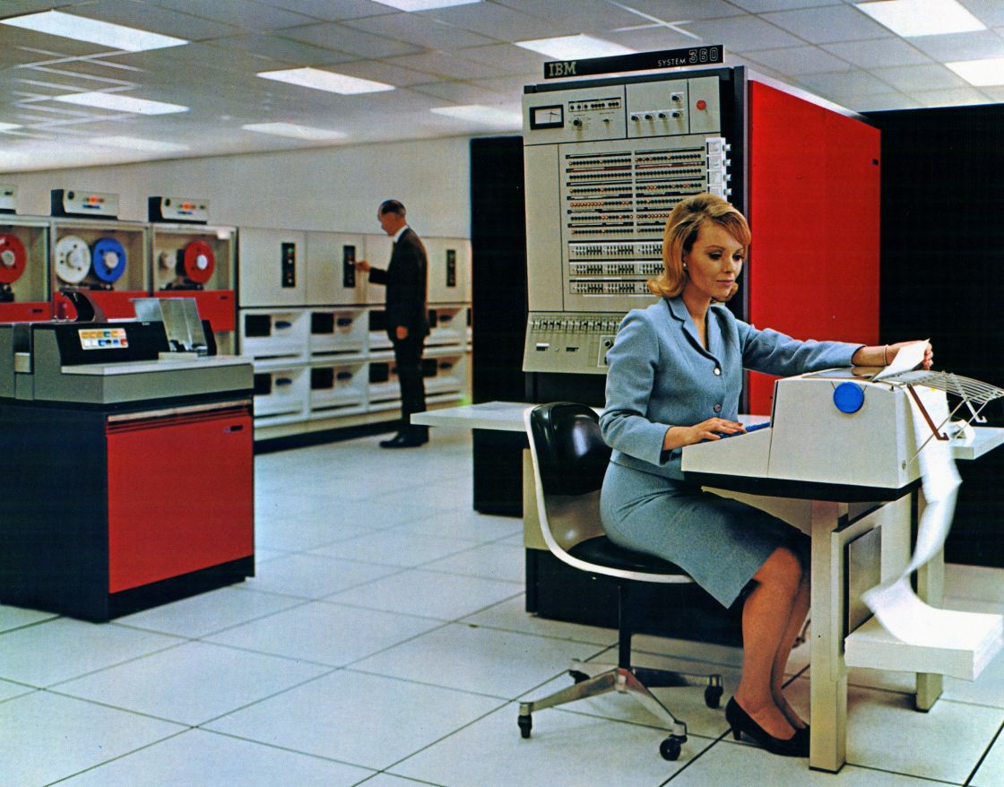
Third Generation Computers ( 1964- 70)
The major breakthrough of this era was development of Integrated Chips , small device which can house millions of transistor on it .
This made computers smaller and more reliable , thought IC’s were little complex to make and maintain.
Well known programming language C was developed in this era , Basic and Pascal were used along.
IBM System 360 was a third generation computer.

Slide 8
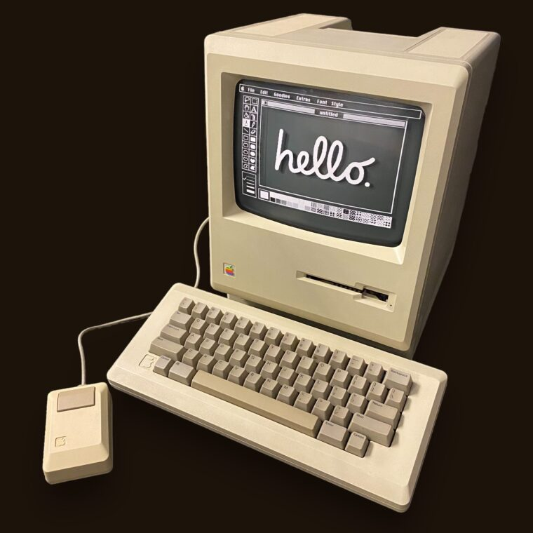
Fourth Generation Computers (1971 – present)
Integrated Circuits led to more complex circuits i.e Microprocessors. Whose task in computes is to read specific instruction , process it and generate relative output.
They are often called as Brain of Computers.
They were less expensive and used less electricity hence made it to general public.
Keyboard , mices are used for input , while output is usually displayed on a monitor or taken on printer.
IBM PC and Apple’s Macintosh (in picture) were first Fourth Gen Computers.

Slide 9
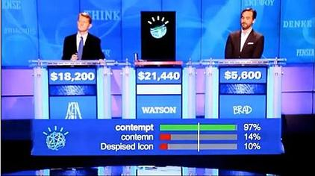
Fifth Generation Computers (present and future)
This generation of computers is to be based on Artificial Intelligence , means these computers can use AI to think , learn and reason.
This can be achieved by making computes , understand natural languages.
This decade saw a boom in AI , as multiple Companies , introduced their generative AI models.
IBM Watson is an AI Computer.

Slide 10
Future of Computers
New techonologies are being developed for computing . E.g Optical computing i.e use light for processing instead of electric current or Quantum Computing where the power of Quantum World is being harnessed to compute on unimaginably massive scales.
Furthermore in future , embedded computer may also act as general purpose computers.

Slide 11
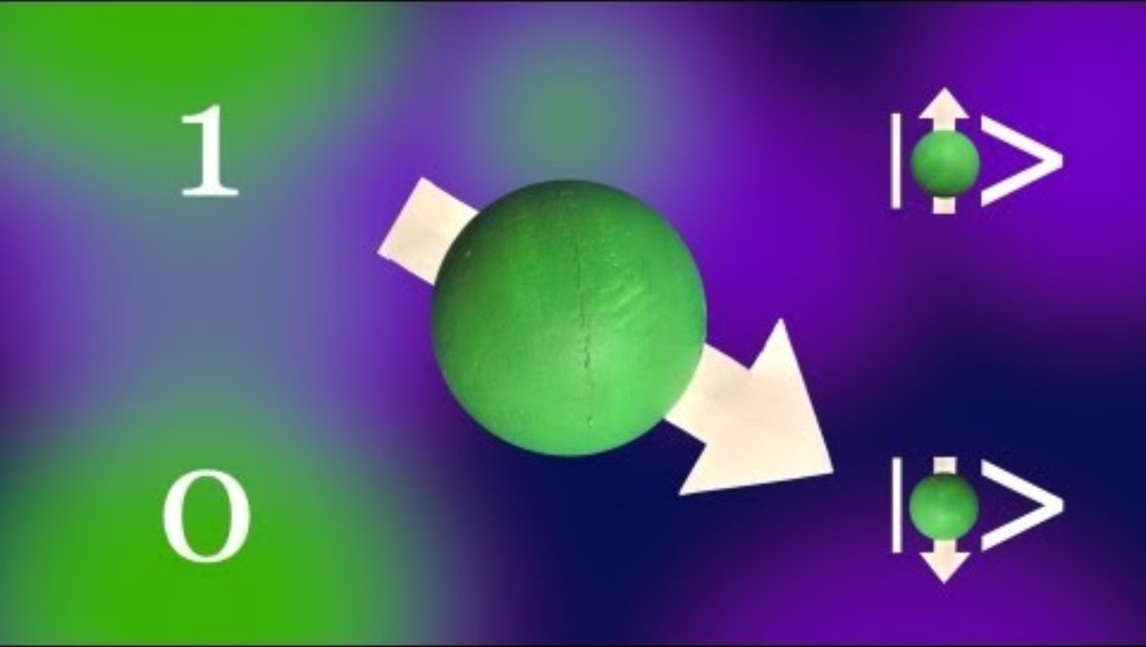
Quantum Computing

